Slide 1




Federal Department of Foreign Affairs FDFA
Swiss Agency for Development and Cooperation SDC
CEDRIG Operational
Climate, Environment and Disaster Risk Reduction Integration Guidance
Material for Facilitators

Slide 2
Opening Session

Slide 3
Objective of the CEDRIG workshop
Bring SDC and key partner staff up to date on the challenges of climate change, environmental degradation and disaster risk in the region
Establish a shared sound understanding of the need and good practice of integrating climate change resilience, environmental sustainability and DRR across sectors
Introduce SDC’s CEDRIG methodology and tool, and enable participants to apply the instrument
Improve planned projects or strategies according to the workshop outcome

Slide 4

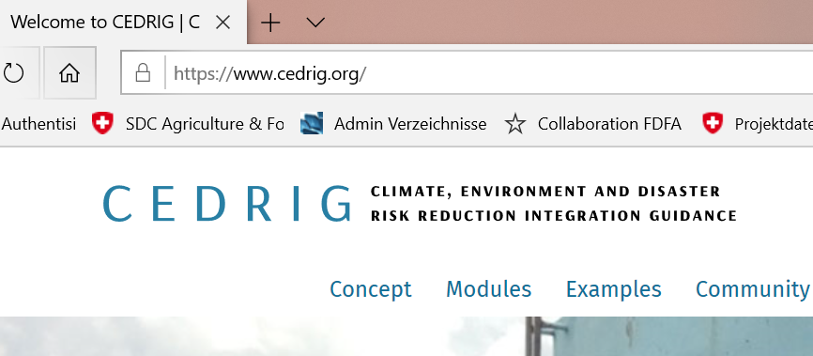
Year | Development of CEDRIG in the Swiss Agency For Development and Cooperation
2004-2008 | CRYSTAL - https://www.iisd.org/cristaltool/ ISSD SEI IUCN Helvetas tool – project proofing tool
2008 | Reorganisation – Global Programmes – Global Programme Climate Change (and Environment) GPCCE
2009 | Decision of GPCC and the Climate Change and Environment Network (CCE) to work on and with a own Climate Proofing tool and to do this with the Disaster Risk Reduction Network (DRR) – aligned to the OECD Policy Guidance «Integrating Climate Change Adaptation into Development Co-operation» http://www.oecd.org/environment/cc/44887764.pdf
2010 | Initial tests in Bangladesh, Bolivia, Burkina Faso and Chad
2012 | First version of CEDRIG – Handbook Part I Aim, Concept and Support Material of CEDRIG (PDF, 509 KB, fr, es) Part II CEDRIG Handbook (PDF, 2,293 KB, fr, es)
2015-2017 | E-version tests in many countries – Daniel
2017 | https://www.cedrig.org/ - Present version of CEDRIG
2019 | Compulsory CEDRIG application for Strategies – Information from Director General Manuel Sager

Slide 5
Tentative agenda of a CEDRIG workshop
Day | Modules | Time
Day 1, 9:00-17:00 | Registration and introductory session | 45’
 | Setting the scene | 45’
 | Analysing the context | 90’
 | Introducing the case studies | 45-60’
 | Getting started with CEDRIG | 60’
 | Reflection | 30’
Day 2, 8:00-17:00 | Field visit | Full day
Day 3, 9:00-17:00 | Risk perspective I | 180’
 | Risk perspective II | 120’
 | Reflection | 30’
Day 4, 9:00-15:00 | Impact perspective | 180’
 | Evaluation | 60’
 | Closure of the workshop | 30’

Slide 6
Getting to know each other
Talk with your neighbour on his/her
professional role
knowledge of the topics climate change adaptation or mitigation, environment or DRR
motivation to attend the training
and present him/her to the audience
Notes:
Talk to your neighbor for 2-3 minutes
Let everyone introduce their neighbor for 30 sec

Slide 7
Expectations of the training
Include a Mentimeter/Slido session on e.g. the following questions
What are your expectations of the training?
What is your level of experience regarding mainstreaming climate, environment and DRR?
What is your motivation for attending the training?
Notes:
- This session shall be shown as an example on how to use mentimeter.
The questions and application can be used for any possible session within the training.
Discuss on the result on the screen.

Slide 8
Setting the scene

Slide 9
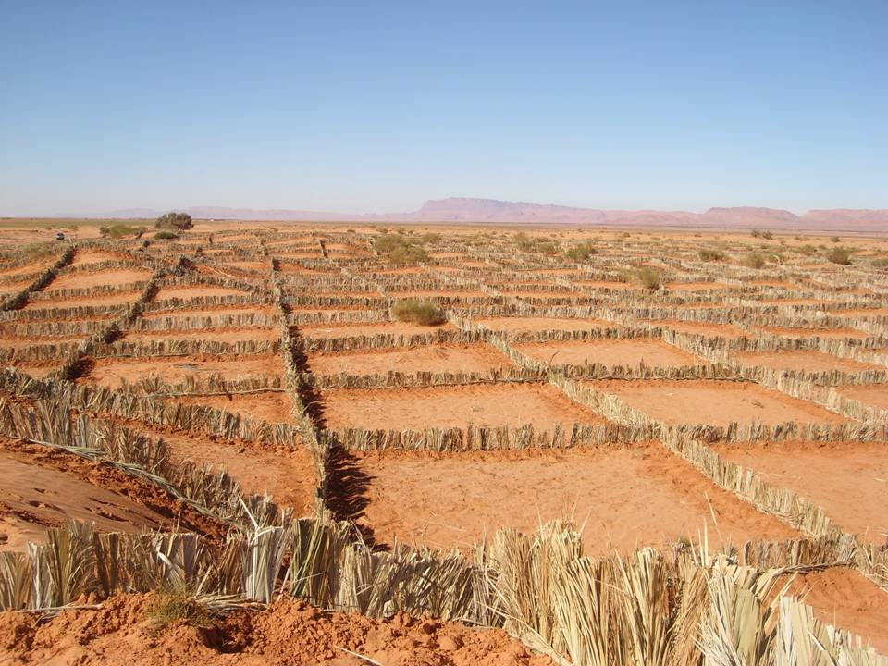
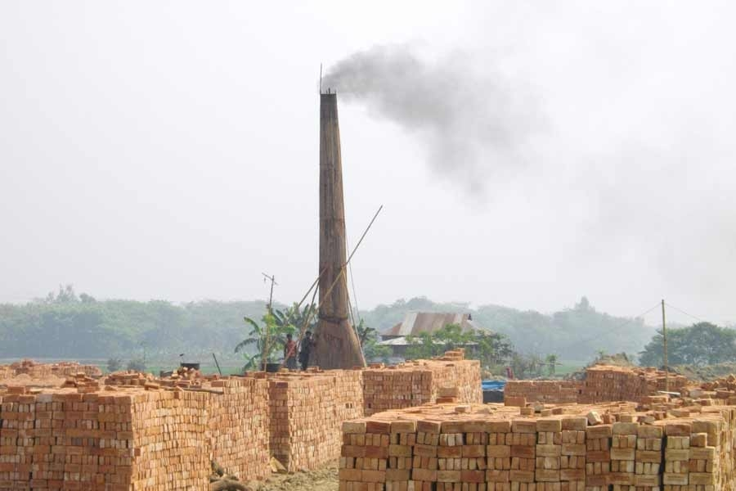
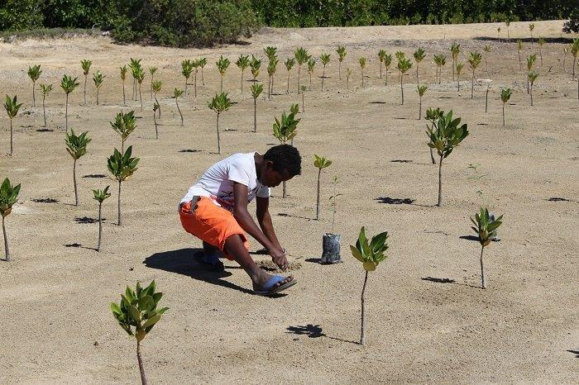
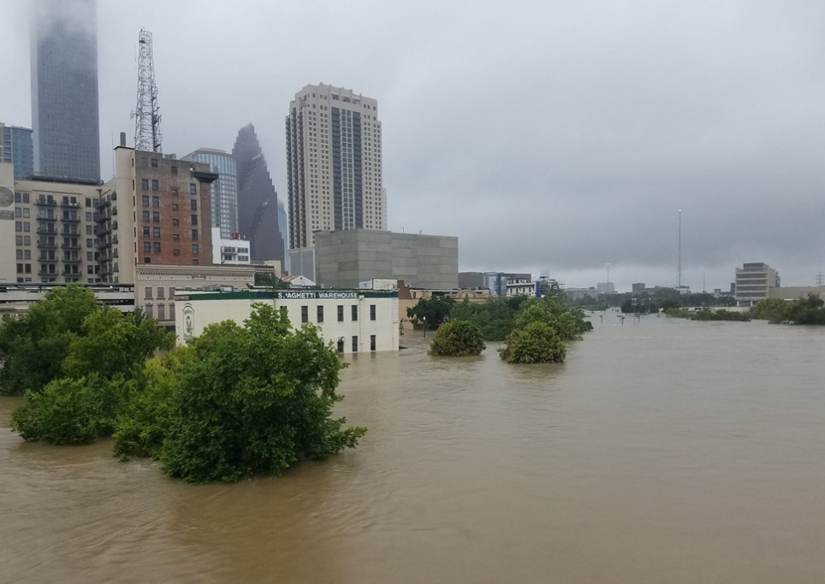
Why mainstream climate, environment and DRR?
Notes:
CEDRIG online is not a tool for climate change and DRR specialists. It is primarily aimed at people working in other areas such as E&I, A&F, water, education or health. Why? catchy picture’ ->
- intention to make mobile livestock farmers settled and promote irrigated agriculture in semi-arid areas (improving income). → is this wise doing in the context of climate change and the threat of natural disasters such as droughts and floods. -- > e.g. it could exacerbate the problem and vulnerability. maladaptation.
- Employment creation – which impact on the environment, on the Climate ?
- Planting of Mangroves: to protect the coast. Is it the correct species in view of raising sea temperatures ? Is he doing this in order to protect the small entreprise just behind the small forest, from cyclones and floods ?
- Urban development: Is the sealing of the soil increaing the risk of flooding ? How about the heat in the City ? How is the interaction between the Urban, and the surrounding rural areas?

Slide 10
Why mainstream climate, environment and DRR?
Notes:
The risk perception is linked to a fact: number of loss events is indeed increasing, mostly risks linked to hydrometeorological events

Slide 11
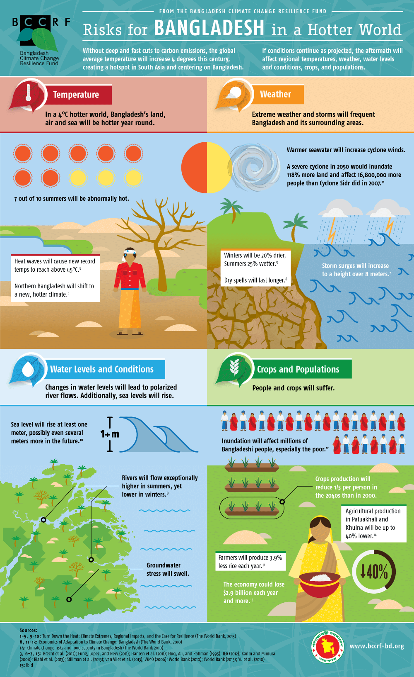
Bangladesh – highly vulnerable to climate change
World Bank 2015

Slide 12
Bangladesh – highly vulnerable to climate change
World Bank 2015
Notes:
Agriculture employs nearly half the population, while making up 15 percent of GDP.

Slide 13
Bangladesh – highly vulnerable to climate change
Especially vulnerable because: Combination of high and increasing population density, geography, poverty, and weak infrastructure
Affected areas: Agriculture & food security, health, cities, energy, ecosystems, water resources, etc.
Agriculture employs nearly half the population, while making up 15 per cent of GDP

Slide 14
Mainstreaming climate, environment and DRR
Integrating climate change, disaster risk reduction and environment
Vulnerability focus
Impact focus
Addressing the drivers
of vulnerability
Activities seek to reduce
poverty and other
non-climatic stressors
that make people
vulnerable
Building response
capacity
Activities seek to build
robust systems for
problem-solving
Managing climate,
environment
and
disaster risks
Activities seek to
incorporate
climate and disaster
information into
decision-making
Confronting cc,
environmental
degradation
and disaster risk
Activities seek to address
impacts associated
exclusively with climate
change, environmental
degradation and/or
disaster risks
Adapted from McGray and Hammill 2007
Notes:
The graph shows a way for mapping out adaptation in the context of development cooperation. On
the left side of the continuum the focus lies on vulnerability and overlaps with traditional development
practices. On the right side, activities seek to target climate change impact, environmental degradation or DRR solely and fall outside
the realm of development. In between lays a broad spectrum of activities with gradations of
emphasis on vulnerability and impacts.
The two boxes in the middle can be seen as the ones we are targeting with CEDRIG.
The concept has been recently reviewed by the authors 10 years later, but still remains meaningful in its core: https://www.iisd.org/story/is-it-adaptation-or-development/

Slide 15
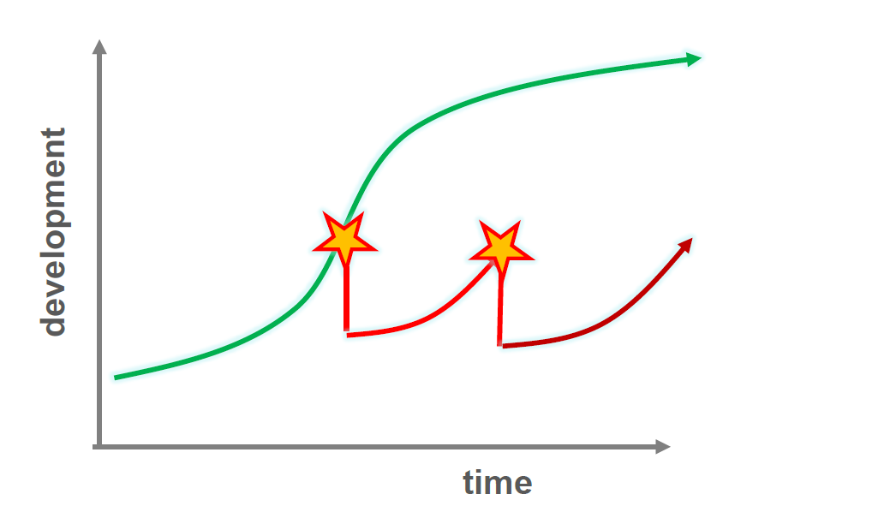
How do DRR and development go together?

Slide 16
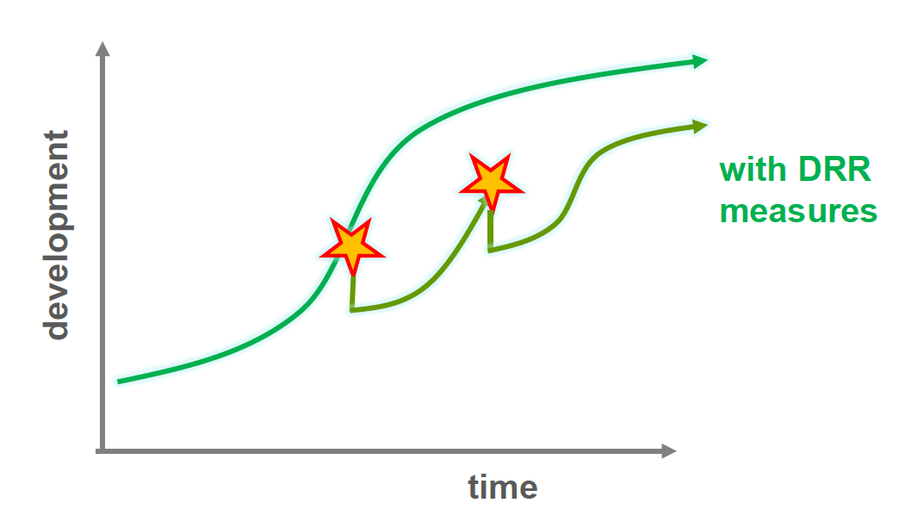
How do DRR and development go together?

Slide 17
Relevance for all kinds of programmes and strategies - Examples
Are the domains of the planned cooperation strategy considering the impacts of climate change on economic development?
Is the rural economic development programme sufficiently incorporating possible environmental risks and resulting changes in work and income structures of communities? Is the programme possibly triggering the increase of GHG emissions?
Is the planned health strategy aware of climate change and potential new vector-borne diseases?
Is the master plan for preserving landscape reserves and forest areas aware of possible future changes in rainfall patterns in the region?
Notes:
Relevance for all sectors

Slide 18
Relevance for all kinds of projects - Examples
Is your horticulture project to advance income and food security incorporating possible changes in rainfall patterns and yield projections? Are planned activities possibly triggering the increase of GHG emissions?
Does the planned construction of a water treatment plant and sewer system have potential negative impact on greenhouse gas emissions or the environment?
Is your health project taking into account possible changes in disease patterns due to climate change or health risks from environmental degradation?
Notes:
Relevance for all sectors

Slide 19
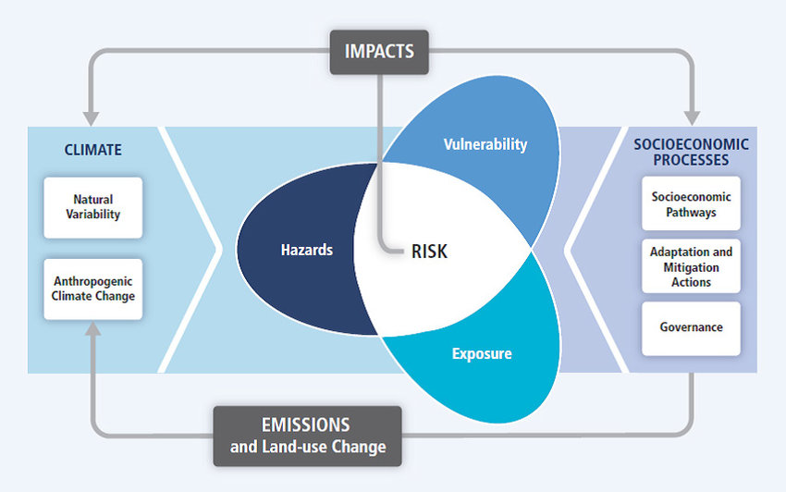
IPCC Risk Concept
IPCC 2012

Slide 20
CEDRIG Risk Concept
Risk
=
Severity of the consequence of a hazard
X
Likelihood of the occurrence of the hazard
Vulnerability is incorporated qualitatively as the root cause of the risk

Slide 21
Getting started with CEDRIG

Slide 22
CEDRIG - the SDC mainstreaming tool
For existing and planned strategies, programmes and projects
Instrument in line with SDC planning processes
Helping to reflect potential risks and impacts: climate, environment and natural hazards
Meant for projects or strategies in all sectors
Notes:
CEDRIG stimulates the process of project/strategy development and helps identifying adequate mesaures;
Instrument for development and humanitarian actors
Possible projects
Care for Support for Teaching and Learning (CSTL)
Gender transformative Sexual Reproductive Health and Rights (SRHR) Systems for Improved HIV prevention
Seed and Knowledge Initiative (SKY)
Matabeleland Enhanced Livelihoods Agriculture and Nutrition Adaptation (MELANA)

Slide 23

Take a dual perspective
CEDRIG assesses both risks
and possible negative impacts

Slide 24
Overall benefit of CEDRIG
Protecting development gains and achieving overall better results of development activities
  more resilient strategies or programmes
  projects with more impact
Avoiding misallocation of development aid money
Ensuring climate change adaptation/mitigation/DRR and poverty reduction are implemented hand-in-hand

Slide 25
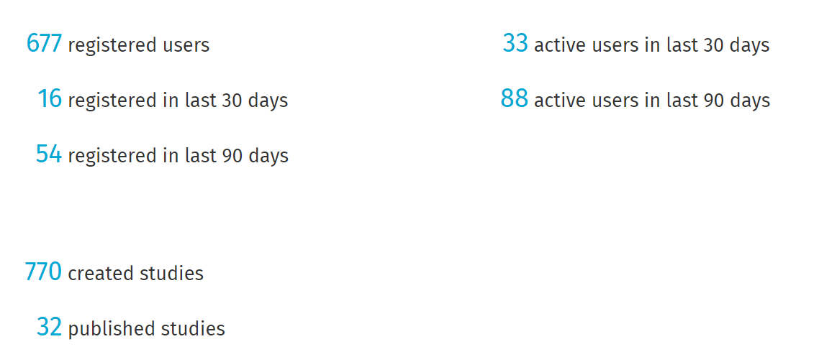
CEDRIG dashboard
CEDRIG is currently available in 4 languages: English, Spanish, French and Russian

Slide 26
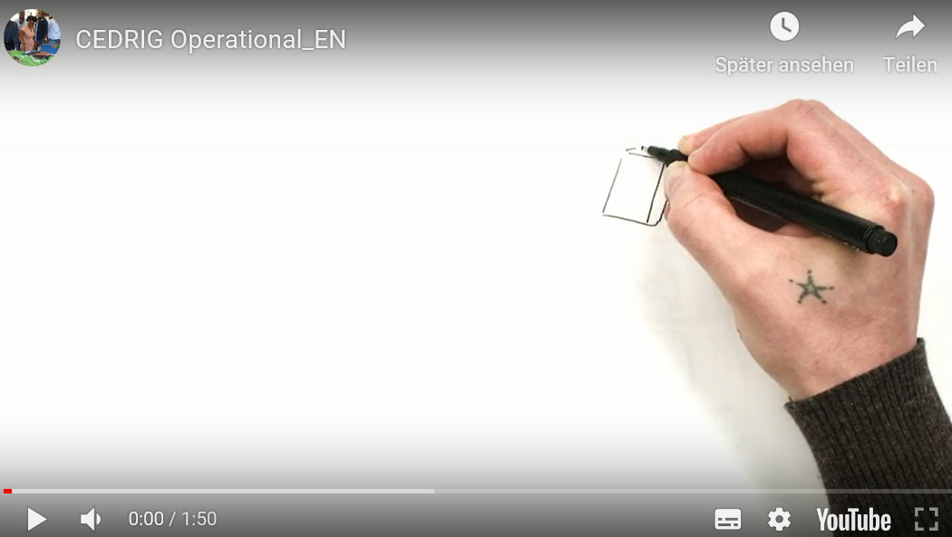
CEDRIG in a Nutshell

Slide 27
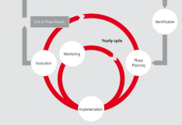
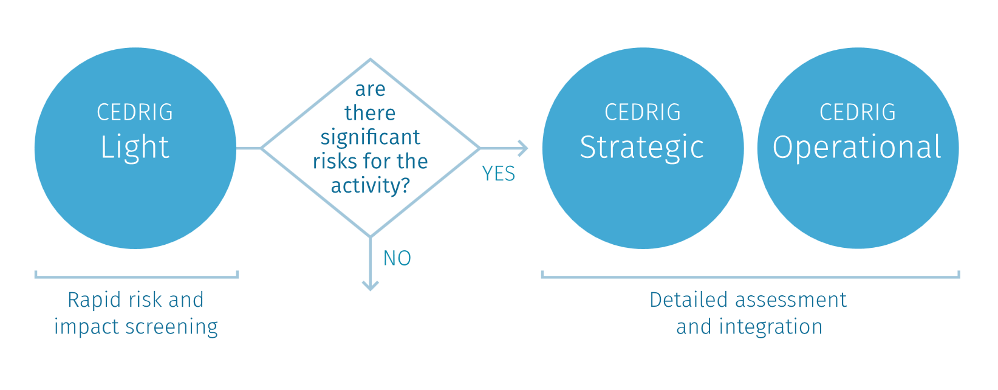
The three CEDRIG modules
Country
Strategies/ Programmes
Project
Country
Strategies/ Programmes
Project

Slide 28
CEDRIG Light
Content
Rapid risk and impact screening
  Is a strategy at risk from CC, environmental degradation or natural hazard?
  Could the strategy have negative impact on greenhouse gas emissions, the environment or natural hazards?
  Is a detailed risk and impact assessment needed?
  Process
Duration: approx. 1 hour
Conducted individually or in small groups
Applied at the beginning of the planning process

Slide 29
CEDRIG Strategic and Operational
 | Strategic | Operational
How? | Multi-stakeholder workshop
What is needed? | Context analysis describing climate change, environmental, disaster risk condititions
Who? | Management staff Project implementers Sssssssssssssssssssssssss Project coordinators Partners
When? | Beginning of the planning process
Duration | 1 day | 2-3 days
Results | Detailed assesment of risks and impacts Identification of concrete measures

Slide 30
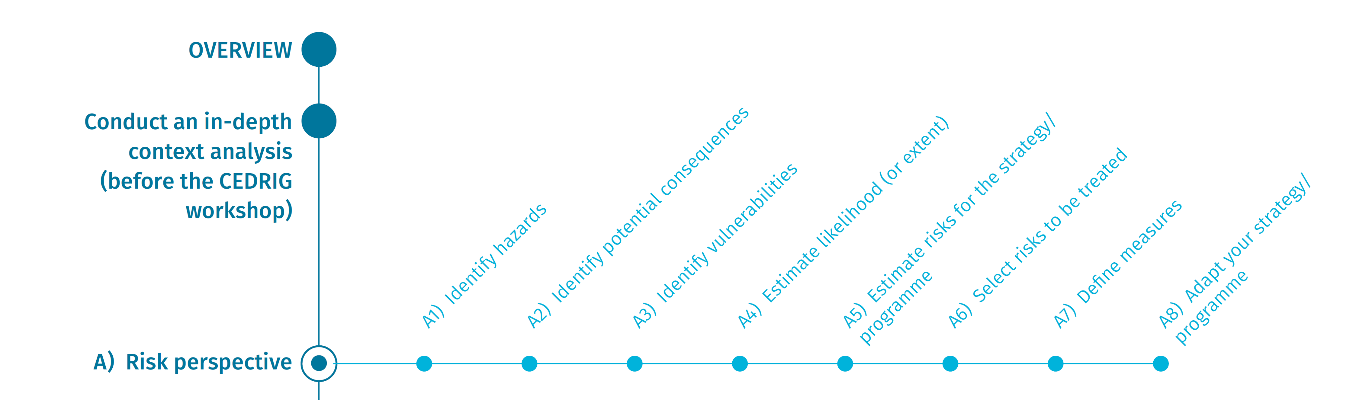
Workflow of CEDRIG Strategic – Risk perspective
Estimate and select
risks
Identify measures
and adapt strategy
Assess hazards and vulnerabilities
Identify measures
and adapt strategy

Slide 31

Workflow of CEDRIG Strategic – Impact perspective

Slide 32
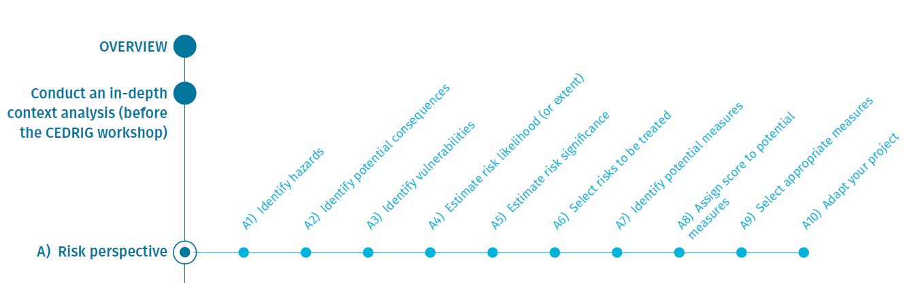
Workflow of CEDRIG Operational – Risk perspective
Identify and assess hazards and vulnerabilities, select risk
Identify and select measures,
adapt strategy

Slide 33
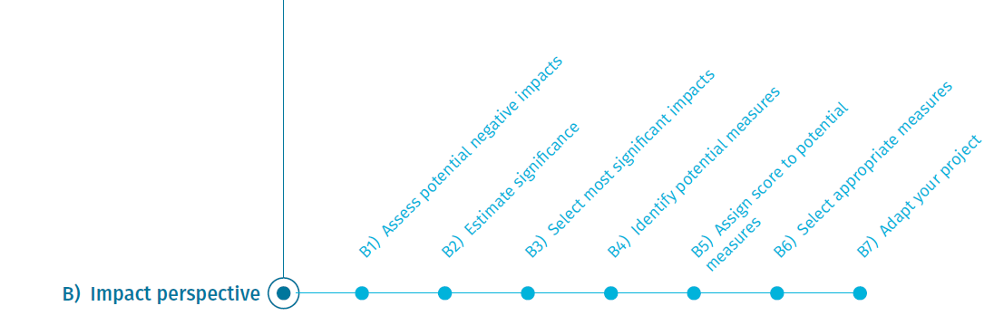
Workflow of CEDRIG Operational – Impact perspective
Assess & select impacts
Identify & select measures
and adapt project

Slide 34
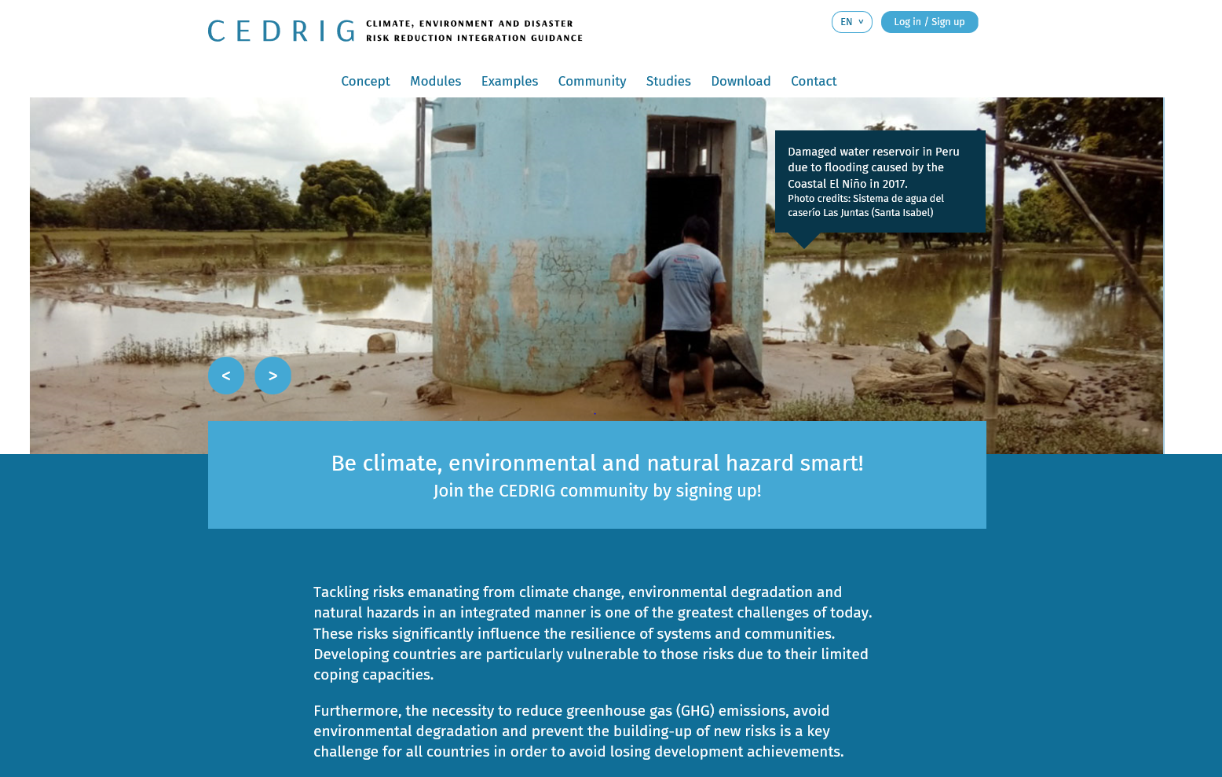
CEDRIG Online version
Notes:
Briefly show the website of CEDRIG.
Everyone can start opening a case.
Show CEDRIG Light appliaction.

Slide 35
Introduction of the project/cases

Slide 36
Case study introduction
Presentation of the case study/the project/the strategy to be assessed
Questions and answers

Slide 37
Risk perspective – Analysing and selecting the risks (steps A1-A6)

Slide 38
The three CEDRIG modules
Country
Strategies/ Programmes
Project
Country
Strategies/ Programmes
Project

Slide 39
Workflow of CEDRIG Operational – Risk perspective
Identify and assess hazards and vulnerabilities, select risk
Identify and select measures,
adapt strategy

Slide 40
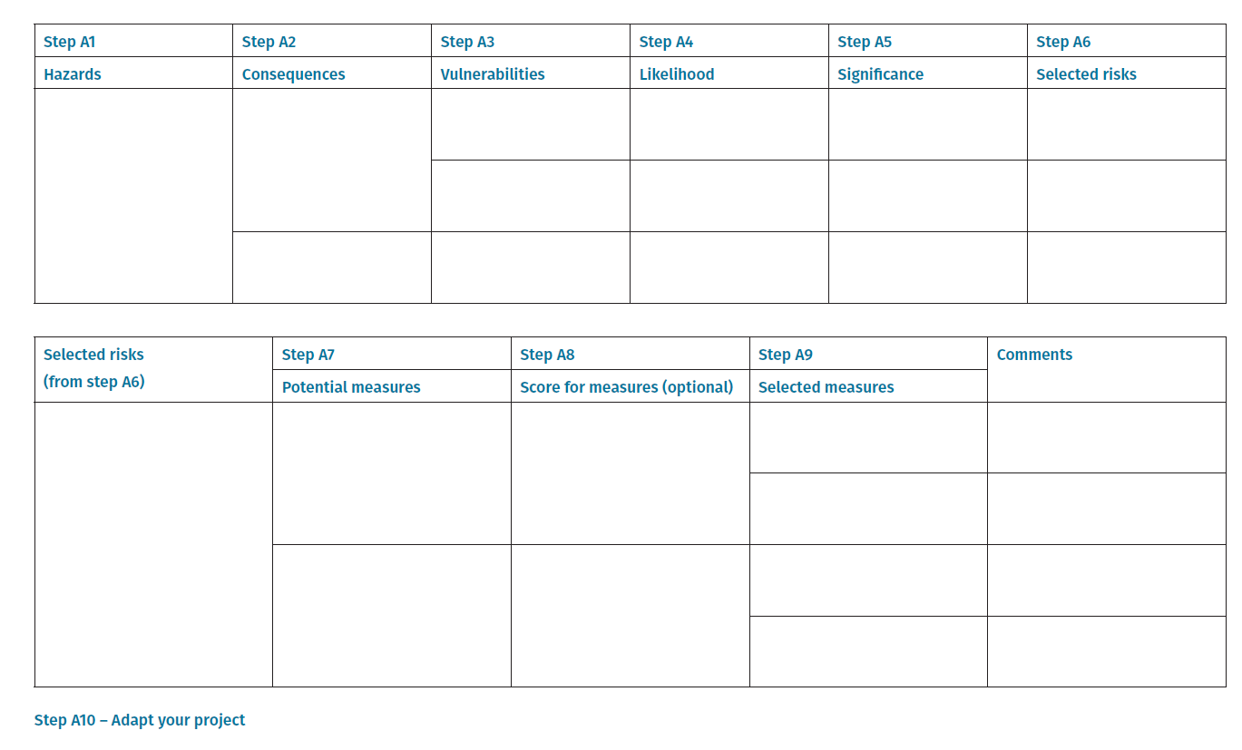
Steps of CEDRIG Operational – Risk perspective

Slide 41
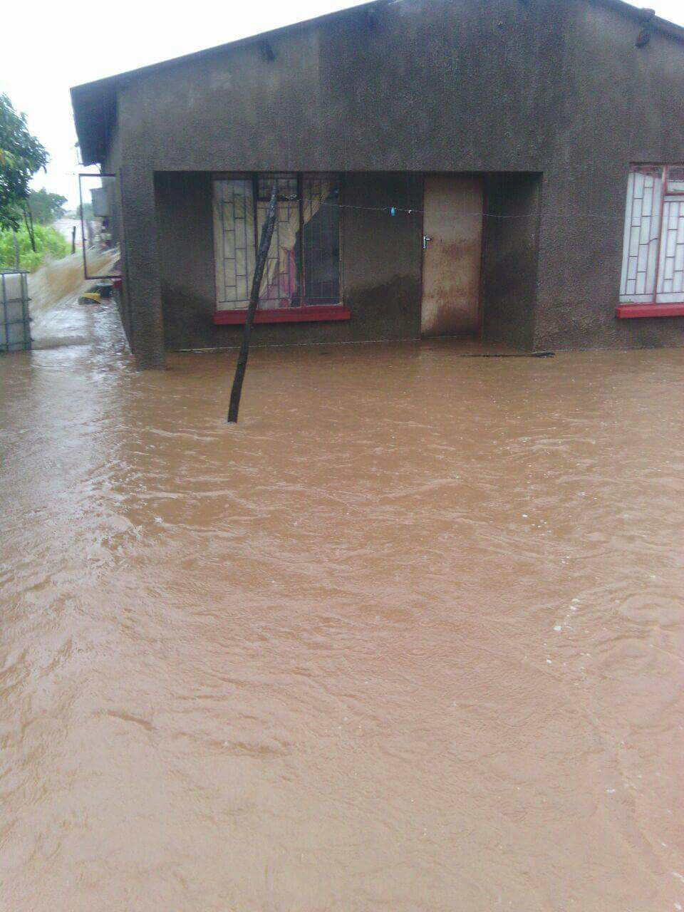
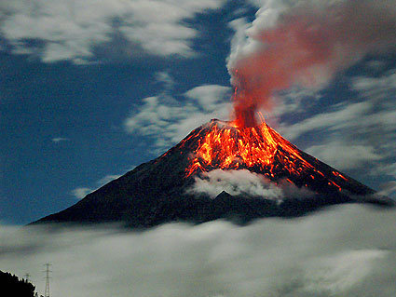
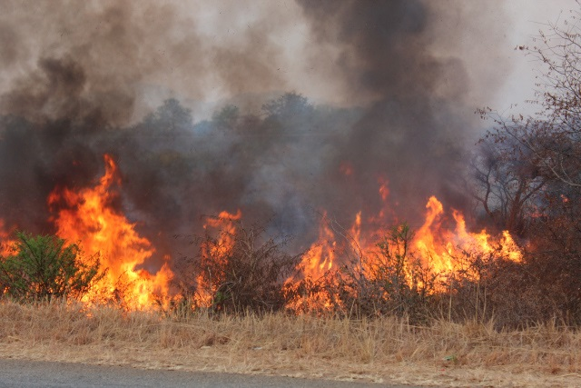
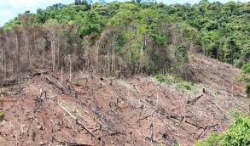
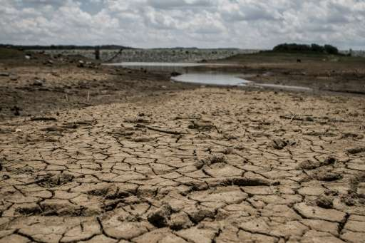
Identify hazards (A1)
Which hazards arise from cc, natural hazards and
environmental degradation?
Floods
Fires
Volcanic eruptions
Droughts
Deforestation

Slide 42
Assess hazards and vulnerabilities (A2-A3)
Questions to be adressed | Examples
Which potential consequences arise for each identified hazard? | Decrease in crop yield Damage to infrastructure Quality degradation of forests and soils
How severe is the potential consequence? | Slightly harmful Harmful Extremely harmful
What are the underlying vulnerabilities for each potential consequence? | Poor social resources Lack of savings and insurance opportunities Poor opportunities to influence political system

Slide 43
Example of Steps A2-A3
Project to be assessed: Cambodian Horticulture Project (promotion of horticulture value chains, sustainable income growth, improved food security)
Example hazard: Droughts
Consequence: Loss of crop production
Extent of the consequence: extremely harmful
Vulnerability: Lack of savings and credits, poor social resources, traditional knowledge no longer applicable

Slide 44
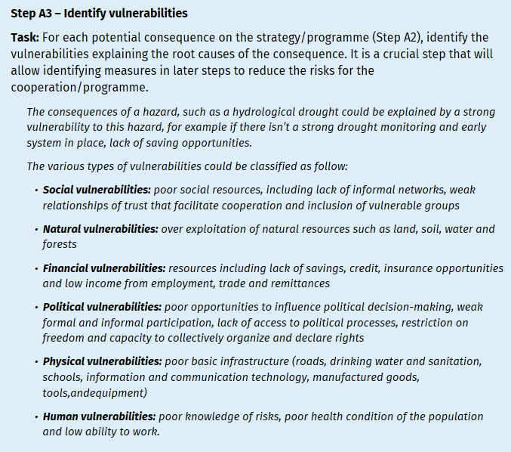
Identify and assess vulnerabilities (A3)

Slide 45
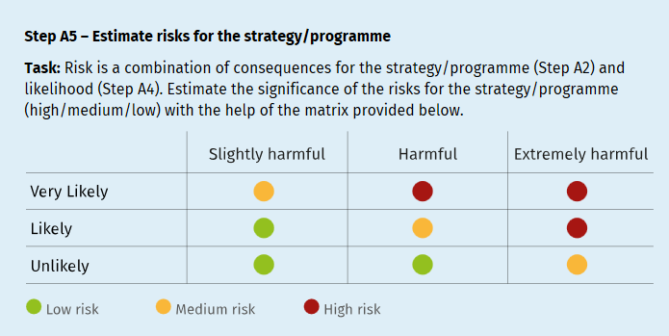
Estimate risks (A4-A5)
Estimate the likelihood of occurrence of each of the identified hazards based on past trends and future projections (A4)
Estimate risks for the strategy or programme (A5) → combination of A2 and A4.

Slide 46
Selecting the risks to be treated (A6)
Have the risks been adequately addressed in the process of project development?
Which ones still need to be treated?

Slide 47
Group work on steps A1 – A6
Work through steps A1-A6 of CEDRIG online in groups
Present and discuss the results in the plenum

Slide 48
Risk perspective – Identifying and selecting appropriate measures (steps A7-A10)

Slide 49
Workflow of CEDRIG Operational – Risk perspective
Identify and assess hazards and vulnerabilities, select risk
Identify and select measures,
adapt strategy

Slide 50
Identify measures (A7)
Project to be assessed: Construction of a water treatment plant and sewer system in Bolivia
Identified hazard: Flash floods, floods
Consequence: Due to flood events, the equipment can not be used and/or broken parts have to be replaced
Severity: Extremely harmful, Likelihood: Likely, Significance: High risk
Identified measures:
M1: Use of water-resistant, robust equipment
M2: Risk transfer measures

Slide 51
Score and select measures and adjust project (A8-A10)
Select measures
Adapt project (logframe)

Slide 52
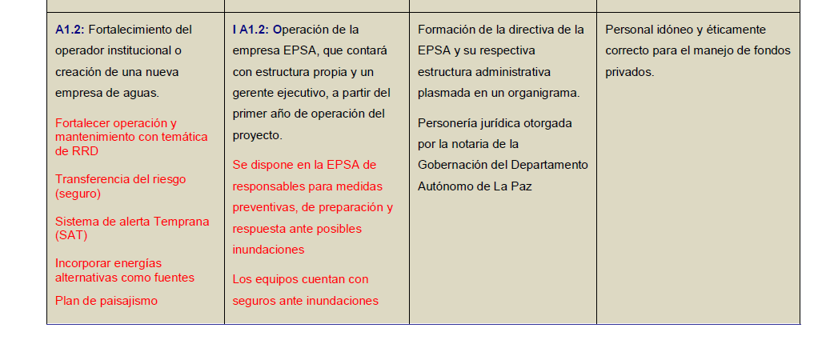
Adapt project (A10)

Slide 53
Group work on steps A7-A10
Work through steps A7-A10 of CEDRIG online in groups
Present and discuss the results in the plenum

Slide 54
Impact perspective

Slide 55
CEDRIG – Risk and impact perspective

Slide 56
Workflow of CEDRIG Operational – Impact perspective
Assess & select impacts
Identify & select measures
and adapt project

Slide 57
Assess the impacts on climate, environment and disaster risks (B1-B3)
Identify the component of the project that could have potential impacts on climate or environment
Estimate the significance of the potential negative impacts identified
Analyse for all the potential negative impacts, and whether they have already been adequately addressed in the project
Select the ones that still need to be tackled with respective measures
Remember that selection is a process of subjective negotiation

Slide 58
Workflow of CEDRIG Operational – Impact perspective
Assess & select impacts
Identify & select measures
and adapt project

Slide 59
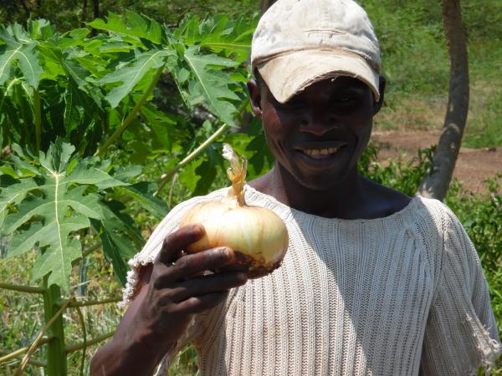
Identify and select measures (B4-B6)
Project to be assessed: Increasing smallholder incomes through horticulture in Mozambique
Component with potential impact: Introduction of tropical varieties from Brazil
Negative impacts: Introduction of new
varieties affect balance of country’s
ecosystems
Significance: High
Potential measure: Phytosanitary testing and certification of all new varieties before import → Score 8 → measure selected
Notes:
Picture: Improved onion vareity IPA 11 from Brazil adapted to tropical climate wtih longer shelf-life

Slide 60
Assign score to potential measure (B5)

Slide 61
Adapt project (B7)
Insert the measures identified under Step B6 in the project
Adapt the results and logical framework
Identify or develop respective indicators for monitoring

Slide 62
Group work on impact perspective
Work through the impact module of CEDRIG online in groups
Present and discuss the results in the plenum

Slide 63
Evaluation of, and reflections on the training

Slide 64
Conduct an evaluation
Relevance and knowledge before and after workshop
Achievement of the workshop objectives
Workshop content, design and moderation
Workshop organisation and logistics
CEDRIG tool evaluation
Notes:
e.g. Evaluation of CEDRIG Workshop Report Final (Harare Workshop 20181)

Slide 65
Discussion on evaluation
What are the most relevant take-home messages?
What concrete ideas do you have to improve the training?
What methods of evaluation do you consider appropriate?
Notes:
Test two methods of evaluation
conventional on paper
test one or two questions with mentimeter

Slide 66
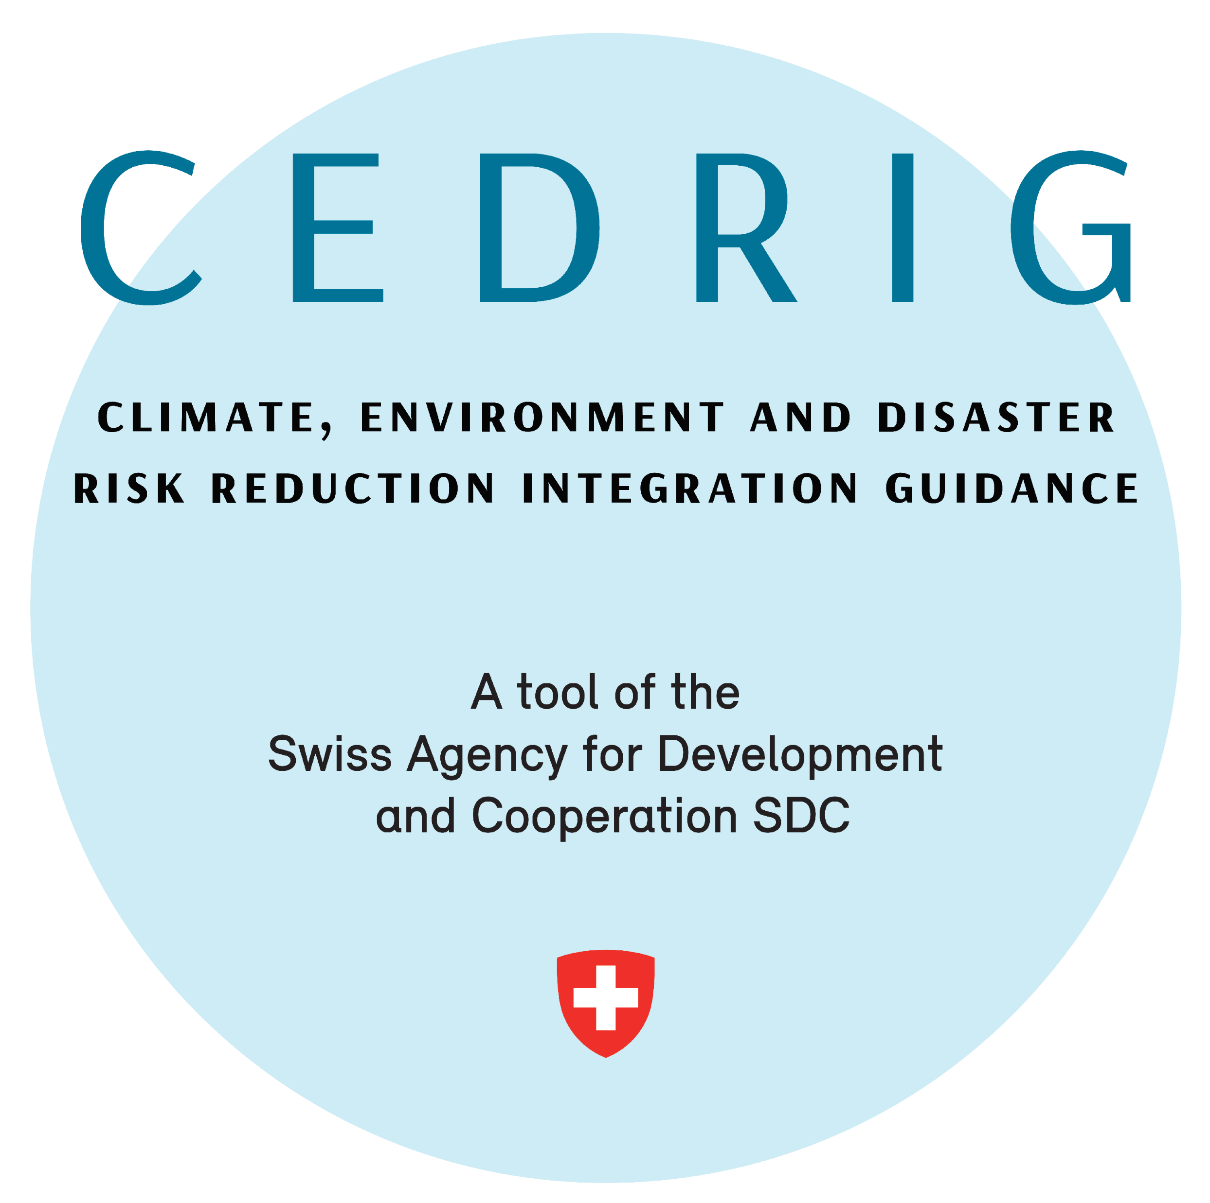
Many thanks for your attention
Focal Point: Patrick Sieber
patrick.sieber@eda.admin.ch
Focal Point: Schmid Jacqueline jacqueline.schmid@eda.admin.ch

